Slide 1
Introduction to Numerical Methods
Mathematical Procedures

Slide 2
Mathematical Procedures
Nonlinear Equations
Simultaneous Linear Equations
Differentiation
Curve Fitting
  Interpolation
  Regression
Integration
Ordinary Differential Equations
Other Advanced Mathematical Procedures:
  Partial Differential Equations
  Optimization
  Fast Fourier Transforms

Slide 3

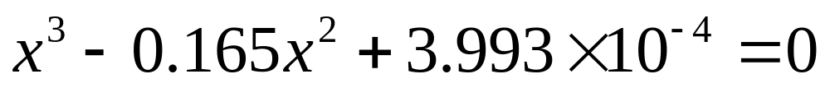
Nonlinear Equations
How much of the floating ball is under water?
Diameter=0.11m
Specific Gravity=0.6

Slide 4
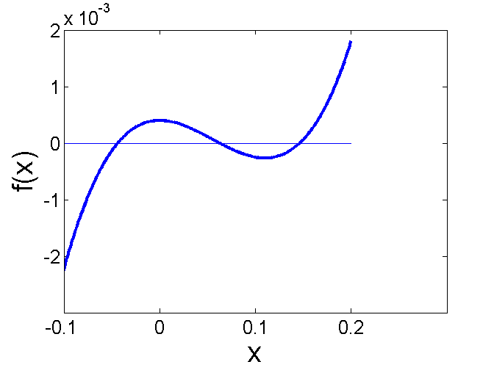
Nonlinear Equations
How much of the floating ball is under the water?

Slide 5
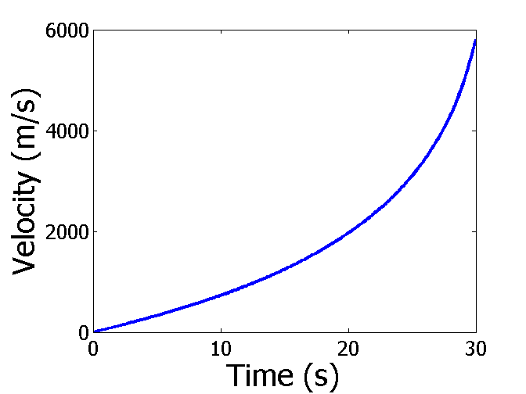

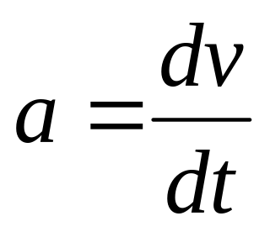
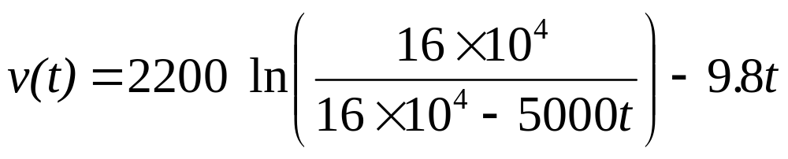
Differentiation
What is the acceleration at t=7 seconds?

Slide 6
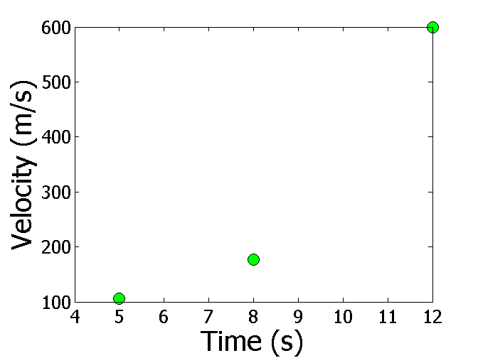
Differentiation
What is the acceleration at t=7 seconds?
Time (s) | 5 | 8 | 12
Vel (m/s) | 106 | 177 | 600

Slide 7
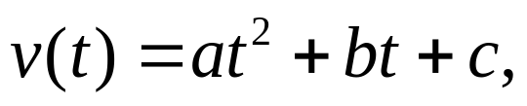

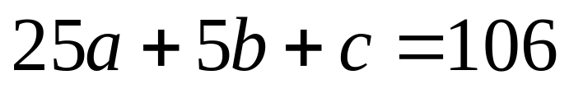
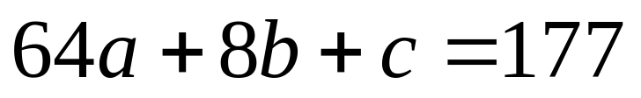
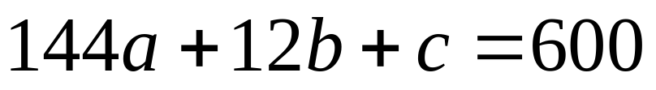
Simultaneous Linear Equations
Find the velocity profile, given
Time (s) | 5 | 8 | 12
Vel (m/s) | 106 | 177 | 600
Three simultaneous linear equations

Slide 8
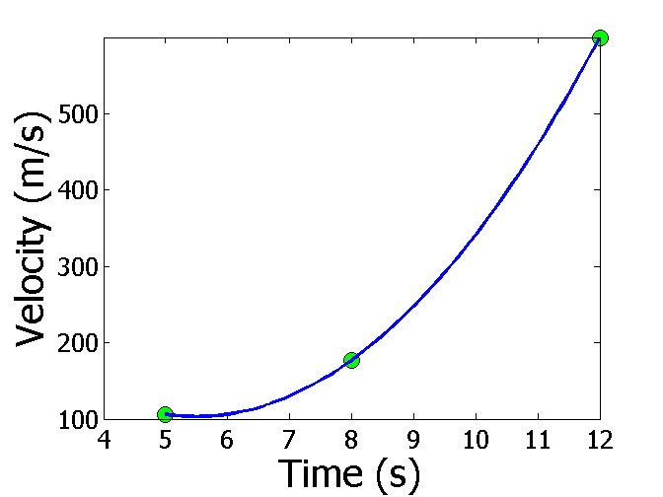
Interpolation
What is the velocity of the rocket at t=7 seconds?
Time (s) | 5 | 8 | 12
Vel (m/s) | 106 | 177 | 600

Slide 9
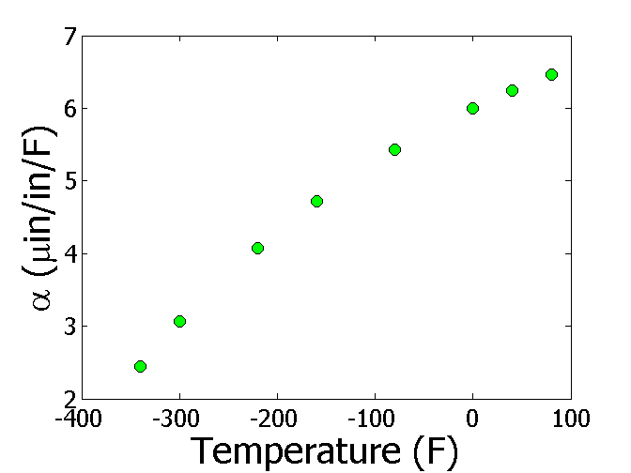
Regression
Thermal expansion coefficient data for cast steel

Slide 10
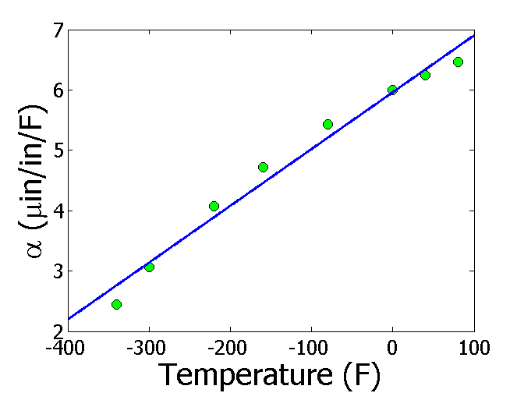
Regression (cont)

Slide 11
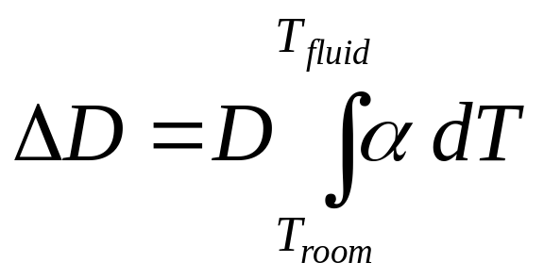
Integration
Finding the diametric contraction in a steel shaft when dipped in liquid nitrogen.

Slide 12
THE END

